Slide 1


IOT BASED PATIENT HEALTH MONITORING SYSTEM
Presented by :
Houssem Balti
Supervisor :
M. Dhafer MEZGHANNI
In front of the jury:
Mr.Dhafer MEZGHANNI Mrs.Siwar Bellahirich
In 29/06/2021
1
University Year 202-2021
Notes:
To start ,I m going to read the plan for my presentation .

Slide 2
Plan
01
General introduction
02
Problematic and suggested solution
03
Used Materials
04
IOT
05
Wiring and testing
06
General Conclusion
2
Notes:
First , we got general introduction
Second : problematic and the solution I suggested
Third : talking about which materials we need in order to create this system
Forth : I will talk about IOT( what is iot , how it works and in which domain it is most used )
Fifth : wiring and testing( digital wiring and real life wiring)
and in the end we finish with a conclusion

Slide 3
General Introduction
Since its first appearance in China in December 2019, Covid-19 has been shaking up the world.
it has spread rapidly around the world since January 2020, confining entire populations, filling hospitals with massive arrivals of patients with severe forms of the disease.
3
Notes:
Hosptials are overloaded cause many problems such as ..(2)

Slide 4
Problematic
• There are increasing number of patients for the doctors to monitor.
• Doctors need to regularly monitor patient health. • The doctors are at risk of infection just for monitoring purpose.
monitoring purpose.
4
Notes:
with the increasing of cases it is becoming difficult to keep a track on the health conditions of this many quarantined patients. Even for patients who goes to hospital to get the proper treatment , they are at risk of getting infected by other viruses or their families who check on them , they are also at risk of getting infected by covid or any other disease which leads to more and more patients .that’s why in order to relieve the pressure in hospitals , I suggest to keep track of patients remotely with iot which is my project that I m going to represent today.
So my solution consists(3)

Slide 5
Suggested solution
This project consists of making a Covid device composed by sensors that allow us to know patient’s health condition that will be displayed in front of him with an LCD and shown to the doctor on a well organized web page.
Then the doctor will decide if the medical intervention is necessary or not.
5
Notes:
To build and create this device , we need some materials : development board to treat the informations from the sensors that i m going use .(6)

Slide 6
Used materials
ESP32
MAX30100
Used Materials
LM35
LCD 16*2
jumper wires
Breadboard
DS18B20
6

Slide 7
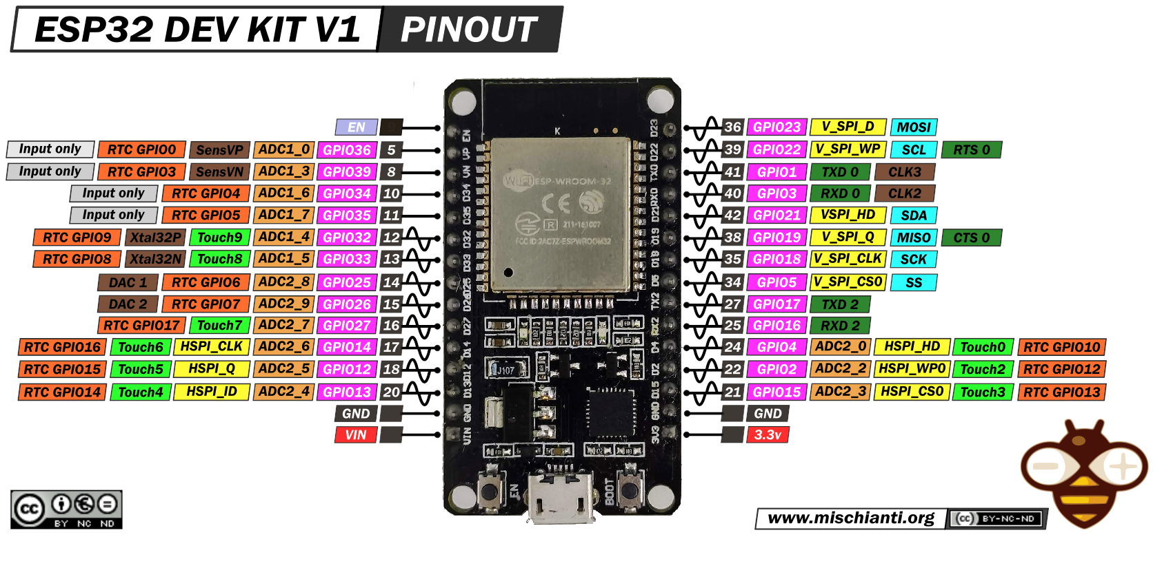
ESP 32
7
Notes:
First , we need to talk about most important part of my project , the development board esp32 its weights is 20 grammes), small device with big capabilities it has an integrated WIFI and bluetooth moodule so we can use IOT ( that’s why it’s so popular for developpers)
Its Operating Voltage vary between 2.2V and 3.6V
This board has :
15 ADC (analog dgitial converter 12 bits )
2 UART interfaces (Universal asynchronous receiver-transmitter)
25 PWM outputs – 25 channels of PWM pins for dimming LEDs or controlling motors.
2 DAC channels – 8-bit DACs to produce true analog voltages.
SPI, I2C & I2S interface – There are 3 SPI and 1 I2C interfaces to hook up all sorts of sensors and peripherals, plus two I2S interfaces if you want to add sound to your project.
9 Touch Pads – 9 GPIOs feature capacitive touch sensing.
Switches & Indicators:
EN – Reset the ESP32 chip
Boot – Download new programs
Red LED – Power Indicator
Blue LED – User Programmable
THIS CARD In tunisian market ccosts 45 dt

Slide 8
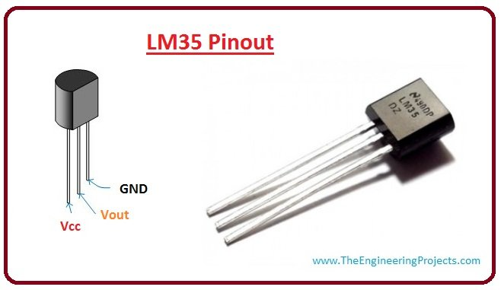
LM35
8
Notes:
It is an analog temperature sensor manufactured by Texas Instruments. It is extremely popular in electronics, because it is accurate, inexpensive, very easy to use and very reliable.it is capable of mesauring temperature from -55 to 150C with a precision of 10 mv per celcus .

Slide 9
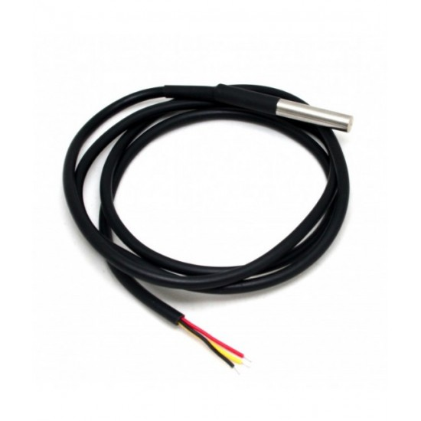
DS18B20
9
Notes:
The DS18B20 temperature sensor is a one-wire digital temperature sensor(exactly it is waterproofed version of the DS18B20 sensor.) This means that it requires only one data line (and GND) to communicate with your ESP32
3 pins :
Red for vcc
Black for gnd
Yellow for iData
This sensor is fairly precise, i.e ±0.5°C over much of the range. It can give up to 12 bits of precision from the onboard digital-to-analog converter.

Slide 10
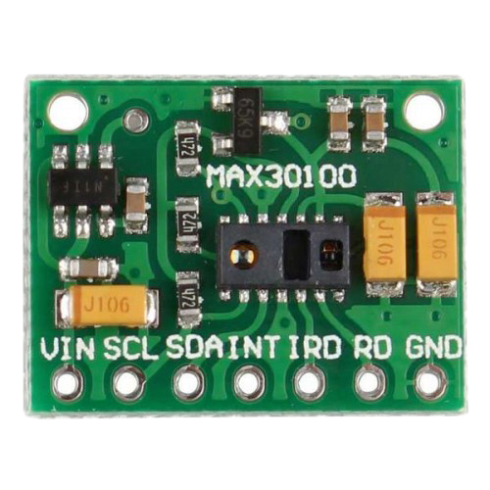
MAX30100
10
Notes:
The MAX30100 is an integrated pulse oximetry sensor and heart rate monitor solution. It combines two LEDs, a photodetector, optimized optics, and low noise analog signal processing to detect pulse oximetry and heart rate signals. The MAX30100 operates from 1.8V and 3.3V power supplies
It is well applied to wearable devices, fitness aids and medical monitoring devices.
This sensor has i2c communication scl D22 et SDA (D21)

Slide 11
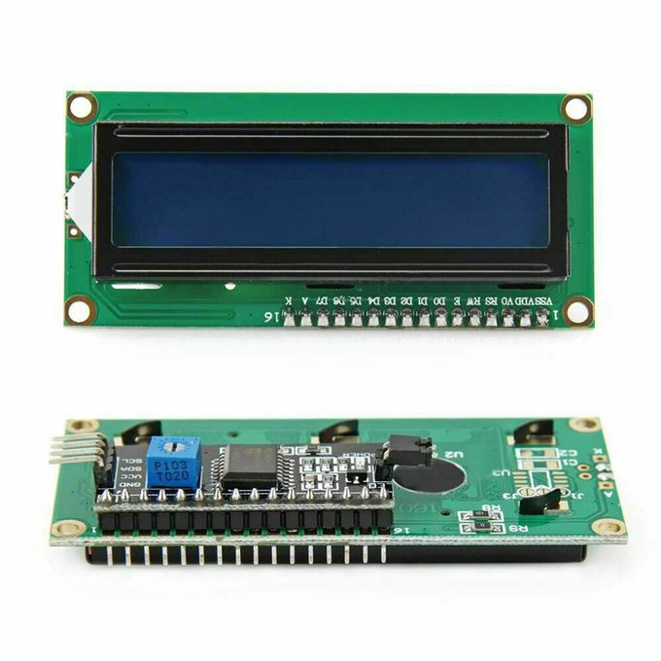
LCD
11
Notes:
The LCD display is in particular a visual interface between a system (project) and the man (user). Its role is to transmit useful information from a system to a user. It will thus display data likely to be exploited by the user of a system.
We have to use our i2c nommunication to wire this lcd to our board .
Power supply : 5V
After mentioning all the sensors , esp32 is mainly used for iot applications .what is iot ?

Slide 12
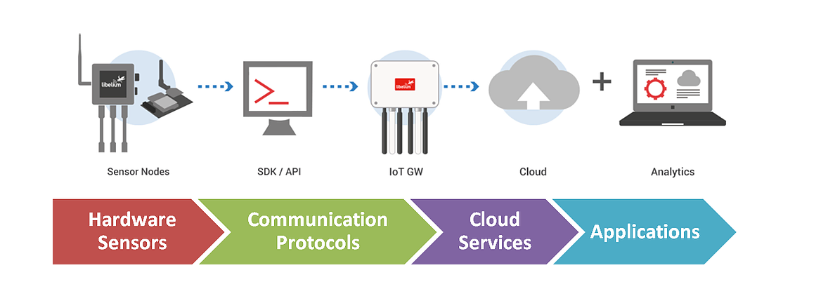
IOT
12
Notes:
The internet of things, or IoT, is a system of connected devices, computers, and mechanical or digital machines with unique identifiers that transfer data over a network. A "thing" in the IoT can be a smartphone, a laptop, a car sensor, or even a heart monitor implant.
How iot works?
Iin this picture we can see how hardware sensors do their thing and transmit to cloud services using the communication protocol and then we reach applications part where we do what we want with those values from sensors.
Iot is used in every domain , but nowadays the most important domain without any doubt is the medical one.
Option :A communication protocol is a system of rules that allows two or more entities of a communications system to transmit information via any kind of variation of a physical quantity.
Iot is used in every domaine , but nowadays the most important domain without any doubt is the medical one

Slide 13
IOT
Benefits of IOT in medical applications
Increased patient comfort and convenience enable better patient satisfaction and faster recovery times.
IoT healthcare devices, wearable technology and data access allow physicians to monitor patients with greater precision and provide better-informed treatment.
UV light sanitation systems keep spaces clean and prevent illness.
13

Slide 14
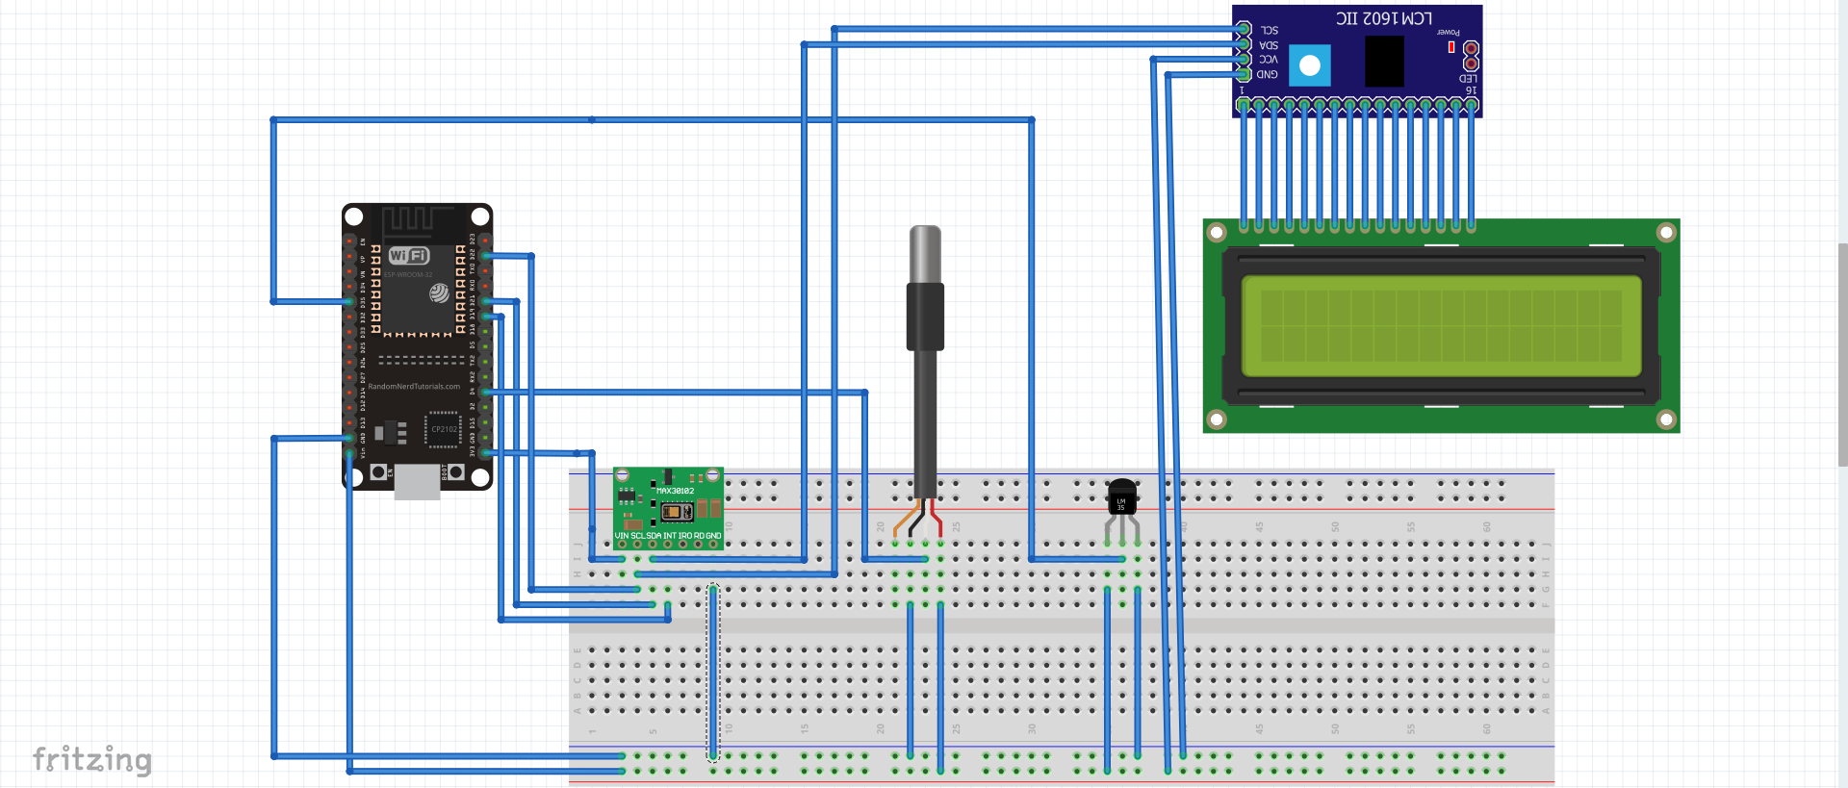
Wiring and testing
14
Notes:
Now we go to the wiring part :
Using porgram called fritzing i was able to wire all my materials in digital form , this picture represent the wiring of my project .but what is interesting is that i m using 2 ic devices in one development board and in order to do that we need to specify their adresses when we are coding.

Slide 15
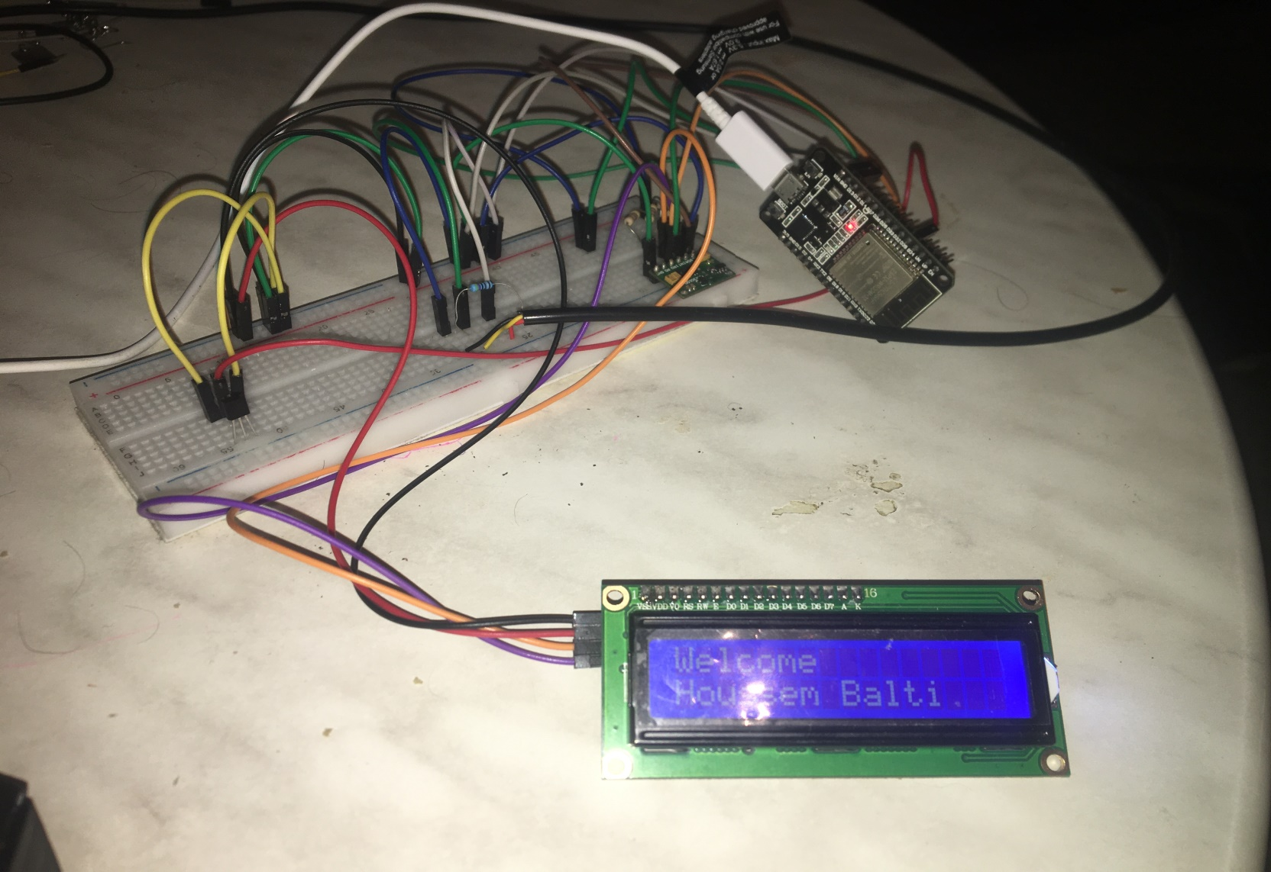
Wiring and testing
15
Notes:
As we see in this picture , 3 sensors : on the left lm35 in the middle ds18b20, and in the right we have MAX30100 all wired to the esp32 and we have the lcd in which the name of the patient is displayed .
How this system works exactly : power on the system
the patient must put his finger on the red led of the pulsing sensor and hold the temperature sensor ds18b20 with his hand
Then esp32 execute the code by connecting to our WIFI at first
Then all the values will be displayed in the lcd
Too long right ? , how about we explain all with a short video

Slide 16
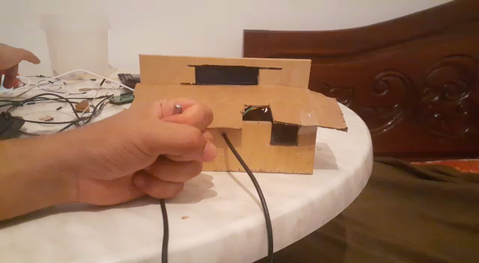
Wiring and testing
16
Notes:
In the screen we have 4 values
BPM : heart beat
SpO2: is the percentage of oxygen in blood
B.T= body temperature
R.T= room temperature
Now all of those numbers will be displayed in a well orgonized web page that is mainly coded for the doctor to check on his patients remotely as we can see here

Slide 17
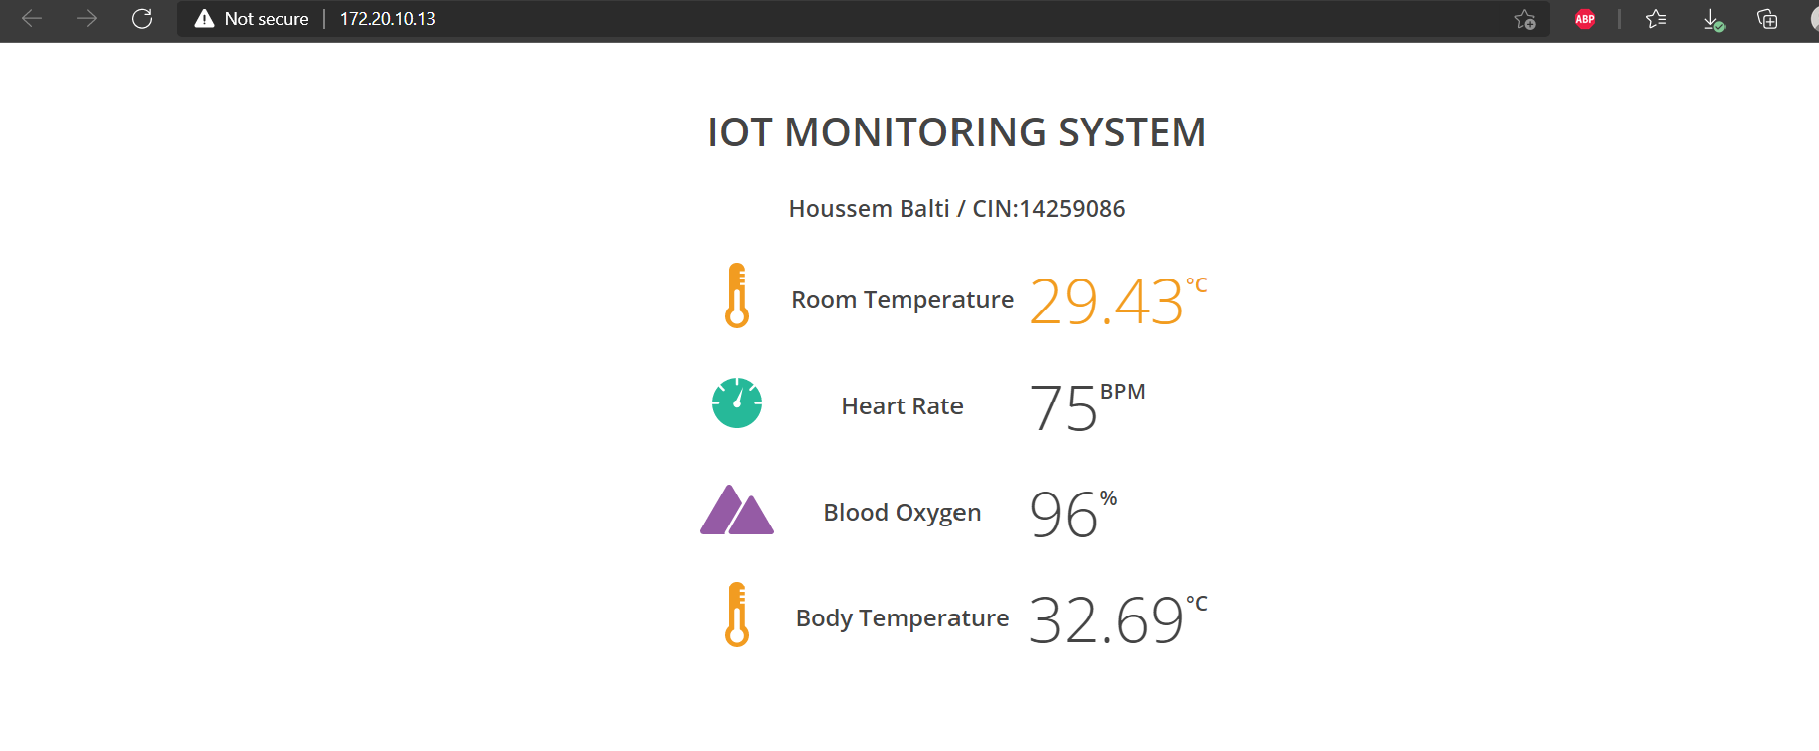
Wiring and testing
17
Notes:
Page web : Is an example of the display … the page web contains room temperature … with 4 logos , we also have the name of the patient and his identity number so that the doctor can identify him through his data .
Also to keep track with the changes of values from sensors this page is refreshing every 3 seconds
If everything is okay the doctor just passes but if we get suspicious values he call for immediat intervention for the patient.
What do we mean by suspecious values :
The normal blood oxygen saturation ranges from 80-100%
heart rate change from 60-100BPM, it also can vary from minute to a minute. According to researchers COVID-19 can cause an irregular or high heart rate - over 100 beats per minute.

Slide 18
General Conclusion
Today, the world is suffering from Covid, Tunisia too. The number of patients is increasing every day, the hospitals are overloaded .the best solution is remotely control them, using IOT technology .
Iot is such fascinating technology that can be used to solve other problems in this pandemic , how many system can we make in order to help the society , even further , how far can iot evolve the humankind
18

Slide 19
Thank
YOU !
19

